Slide 1
Functional Harness
Exercise:
- Retrospective

Slide 2
FUNCTIONAL is EASY

Slide 3
Functional Code
1. All inputs
2. deterministic
3. All results

Slide 4
Non-Functional Code
(No Inputs)
get inputs from global state;
use random, dates, or other varying data;
write results to global state;
(No Return)

Slide 5
NON-FUNCTIONAL is HARD

Slide 6
Reduce To Functional
Functional?
Yes
Easy
No
Hard
Reduce to
Functional
Notes:
If it’s hard to test, change it so it’s easy
The solution to testing hard code isn’t to get good at testing hard code
The solution is to make the code itself easy to test
This whole set of exercises is showing different tricks to make code look like it’s functional, returning info for testing

Slide 7
System Configuration
void start()
Log
Easy Capture of Configuration
Start
SystemConfiguration ending = start(startingConfig);
Notes:
One version of hard-to-test-code
It’s hard because no inputs and no outputs – setting up global data
By adding logging, we can visualise – concept is “we have a starting configuration” and then “an ending config”
Now you can think of it like the code at the bottom of the slide
In the exercise, we may have ended up with a step on the way to the interface shown at the bottom here

Slide 8
Make the Implicit Explicit
Notes:
Before, there were implicit global variables.
And now we have ability to explicitly set them
We’re going to use this technique a lot when testing code that has side-effects

Slide 9
In tests, as in life, the starting conditions make all the difference
Notes:
Often things are hard because we need to get in to a particular state, to make test work
As soon as we logged, we created code to make it so we could both read the state and reproduce it

Slide 10
Where does the testability code go?
1. In code
2. #ifdef in code
3. In separate header
4. In test file
Notes:
Where do we put the testability code?
1 Put logging directly in to production code – so it always logs
2 Put in on production code, but only compile it for the tests
3 Put it in a separate header in production code, that’s only included by the tests, Advantage: no ifdefs, and printing is close to production code
4 It’s completely removed from production code, but is separate so is more vulnerable abandonment – and getting out of date

Slide 11
Logging
void start()
Log
Easy Capture of behavior
Hard
Logs eventLogs = start();
Notes:
Logging record of the test that was executed, as a way of testing the implementation
Making the implementation visible for testing
Conceptually, we are running a function and getting back info about what it did

Slide 12
0
+Logging
Notes:
If you had no logging, and then you add some, you don’t have to consider anything else

Slide 13
7
+Logging
Notes:
If you have a few lines of logging, then you have to decide whether existing logs are going to interfere – or vice versa
Probably want them to co-exist

Slide 14
99,999
+Logging
Specific Logging
Notes:
If you already have a lot of logging, you may want them to co-exist, because you want lots of detail
Or you may want to add a separate logging channel – to avoid too much noise to signal
You don’t want your specific tests failing when the other logging changes
Also, how long do you want the logging to last?
Maybe a few days, or a few hours?

Slide 15
Files (name & size is usually enough)
void writeFilesFor(std::string name)
FileA 34,368
FileB 15,632
FileC 28,453
std::string directoryFileList = writeFilesFor(“Clare”);
Notes:
If the code you are testing writes out files, you could capture the whole file content
Or you could capture filename and byte size, as a kind of a checksum
Or you could add MD5 checksum too –though harder to interpret if there’s a failure
You decide what’s good enough
Don’t have to save every detail – think about the code of what you’re saving, and the risk
Filename and byte size is usually sufficient
Depends on context – public key, not enough!

Slide 16

Databases
void insertIntoDatabase(Parameters p)
✔
DatabaseLogs sqlStatements = insertIntoDatabase(parameters);
Notes:
Given a known initial state of a database, database code is deterministic
But setting this up is hard and slow – and not always worthwhile
Databases are usually not deterministic – based on state already in the database
Llewellyn’s story about large complex SQL function and breaking it up

Slide 17
Changing Output

Slide 18
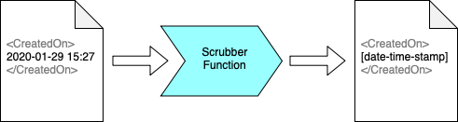
Scrubbers
Notes:
Scrubbers are an approval tests concept for converting unstable output to stable output, without changing the code being tests
Here, we are changing a date and time to some fixed text

Slide 19
std::string scrub(const std::string& input)
Scrubbers::createRegexScrubber(R"(\d+)", "[number]")
Notes:
Top line shows the signature for a scrubber
Creating this for regexes is hard
So we have createRegexScrubber as a convenience function, to do the work for you

Slide 20
Changing Code

Slide 21
The Hard Parts
Non-deterministic code
Third-party code
Non-compiling code
Hard-to-set-up code
Code I don’t have a licence to run
Slow-running code
Code that needs other services, applications or hardware
Anything else that annoys you
Notes:
What do we mean by Hard Parts
Big pattern: anything that annoys you

Slide 22
The Peel
Notes:
The hard-part was the time
Separate one method in to two
Ignore the first method – just calls now()

Slide 23
The Peel
Goal: Separate the method in to 2 methods
Identify that the hard part is all at the beginning (or end)
You may need to refactor for this
Refactor to extract all else into a separate method
You now have two methods
The original method: small, simple, hard-to-test
Your new method: holds business logic, easy-to-test
Test the easy thing; ignore the hard thing

Slide 24
The Slice
return sample

Slide 25
int getID()
{
srand( time(0) );
return (rand() % 10 + 1);
}
Notes:
Original code
Bit in red is hurting us

Slide 26
1. #ifdef TESTING
int getID()
{
#ifdef TESTING
srand(500);
#else
srand( time(0) );
#endif
return (rand() % 10 + 1);
}
Notes:
Pro: Edit is localised
Pro: Convenient Intermediate step on way to better code
Con: Requires code to be built twice – once for prod and once for testing
Con: Risky – hack may get built in to production code

Slide 27
2.
passIn(seed)
int getID()
{
time_t seed = time(0);
return getID(seed);
}
int getID(time_t seed)
{
srand(seed);
return (rand() % 10 + 1);
}
Test This
Notes:
Pro: Easier to understand
Pro: Less global state
Pro: Standard refactoring
Con: Tests don’t show intention, only results, as seed does not correlate with result

Slide 28
3.
passIn(rand)
int getID()
{
srand( time(0) );
int random = rand();
return getID(random);
}
int getID(int random)
{
return (random % 10 + 1);
}
Test This
Notes:
Pro: Easier to understand
Pro: Less global state
Pro: Standard refactoring
Pro: Tests show intention, as random does correlate with result
Con: Can be harder to understand the code enough to make this cut

Slide 29
Side Effects
Demo!

Slide 30
RETRO
💬

Slide 31
Further Resources
bit.ly/TestingCpp

Slide 32

Future Training
4 x 2-hour sessions
+ Optional 2-hour consult
bit.ly/LegacyCppNov2020
THANKS!
Please connect on LinkedIn and Twitter
Notes:
https://blankcalendarpages.com
https://blankcalendarpages.com/November-2020-calendar
Scroll down for Comic Sans one
Or build custom one

Slide 33
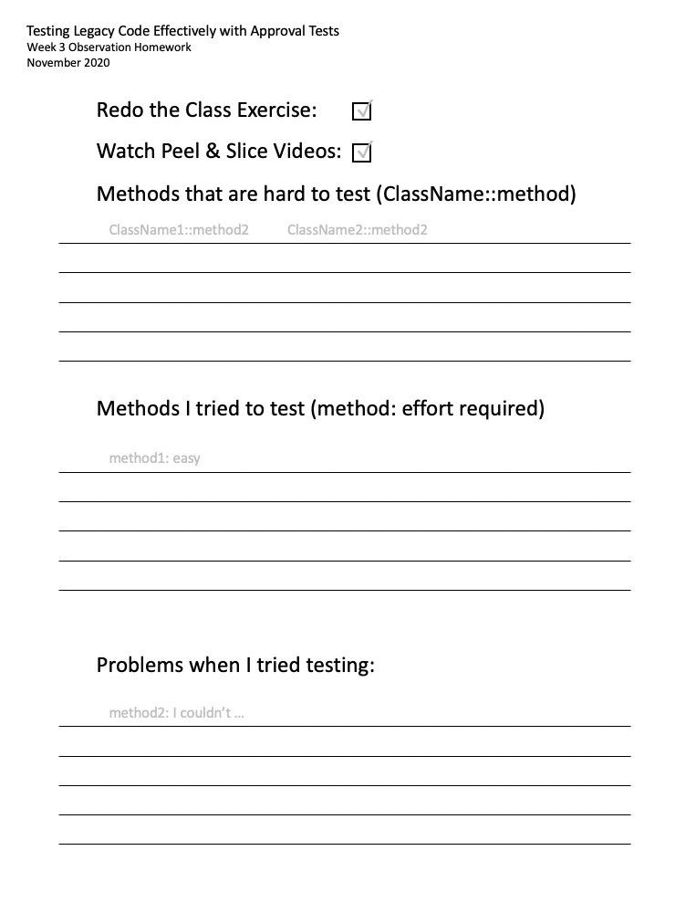
Homework
Redo the exercise, solo
Take notes around testing
Watch videos
Notes:
Difficult: Anything you saw that was “Oh that would be hard to test”. No action required
I tried: “Any time you tried to test something, make a note”. Action, but optional
Problems: “I tried to test this, and then couldn’t figure out how to solve it”. Action, but optional

